Slide 1
How do soil properties influence microbial communities?
—— A research in the Loess Plateau area
Program Pathway: Biotechnology Engineering & Healthcare Technology
BIOB-G1: 42
GUO YIXIN
QIU HAOHONG
PENG BOHAO
HOU RUIHAN
WEN YUFENG
Background & Data and methods
Description on between-sample diversity
Description on in-sample diversity
Inherent mechanism in driving these changes
Prediction model & Application and evaluation

Slide 2
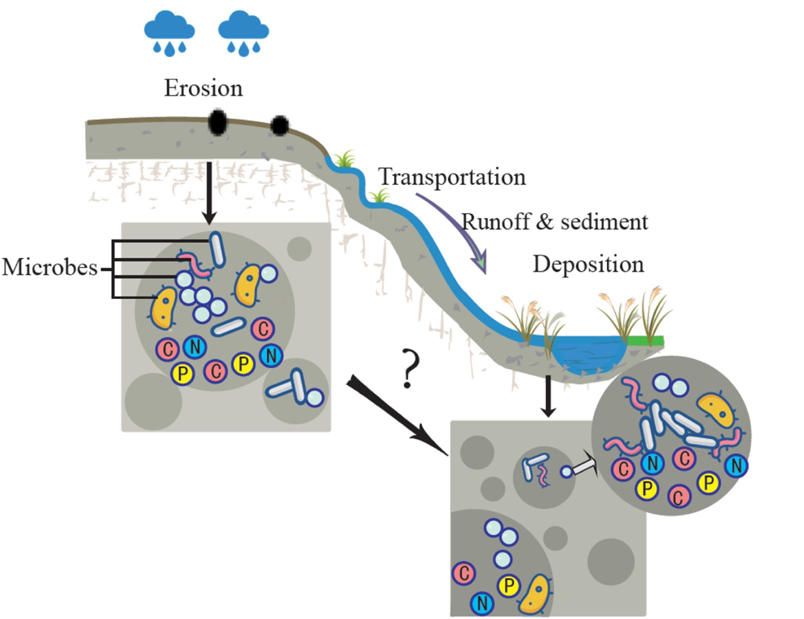
GUO YIXIN
I. Background
Why
Role of microbes
What
Way of describing soil microbes
Inherent relationship between soil properties and soil microbes
Prediction of soil microbes
1
Notes:
Soil microbes play a significant role in the ecosystem and are involved in many environmental mediation processes, for instance, nutrient cycling and plant growth, which are essential to environmental preservation and agricultural development. Understanding how soil microbes changes in response to soil properties is both needy and
How to describe the distribution of microbes, how to identify the changes in microbes after erosion/trans/depo, what in fact causes this change?
(HPQ)
Furthermore, how to make predictions about microbial info

Slide 3
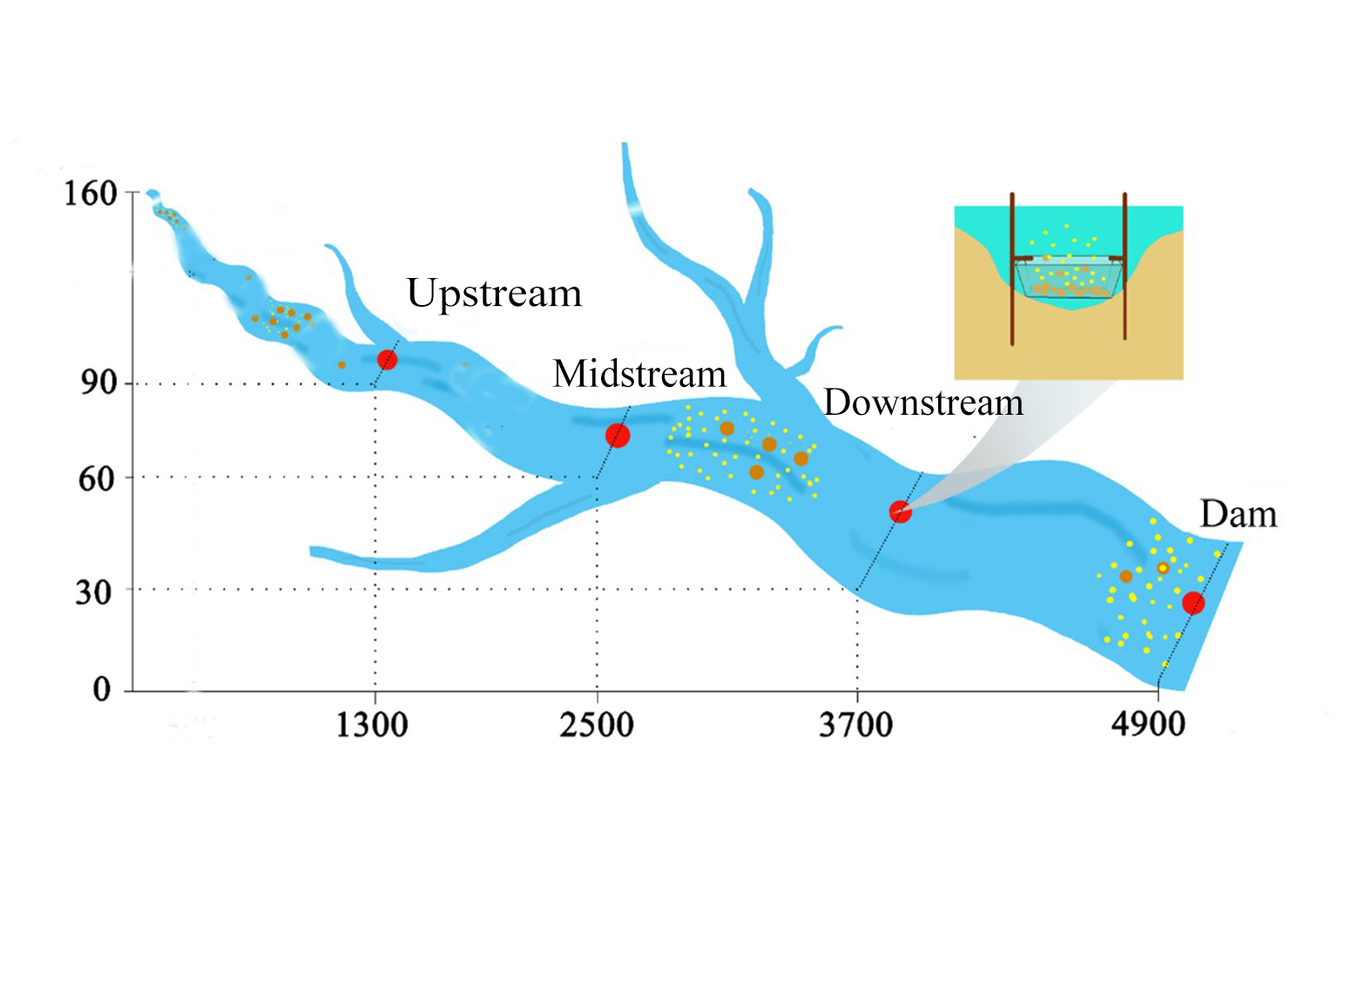
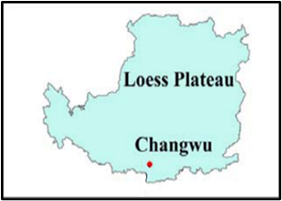
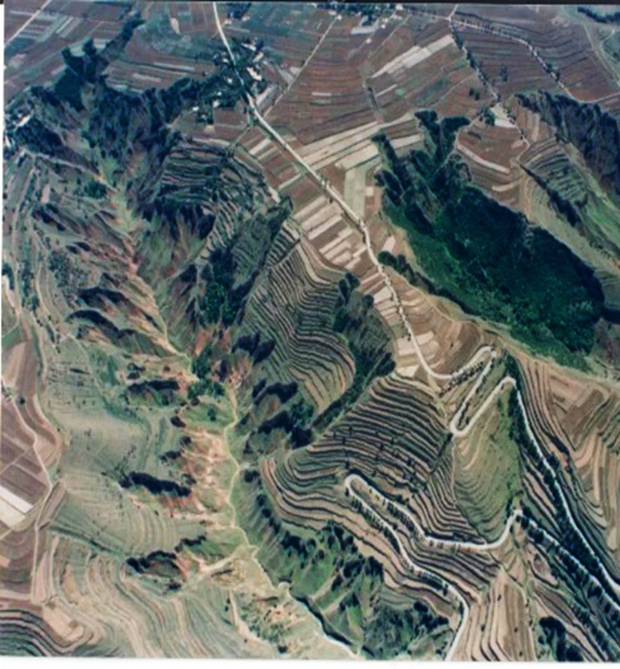
GUO YIXIN
II. Data & Methods —— Sampling and Data
1200
Gully head
Altitude (m)
1130
1100
1070
1040
1300
2500
3700
4900
Sampling sites along the river (m)
Soil properties: SOC, Olsen-P, TN
Microbial information: high-throughput sequencing data
2
Notes:
We choose changwu in Loess plateau, a place in China which is an erosion area. Microbes inhabited in the soil are the most abundant and most actived on the land surface 引用
5 sampling sites(1 3 4 6 7) are distributed along this river according to the altidude
Soil organic carbon Olsen phosphorous total nitrogen
high-throughput sequencing data like 16s-rRNA which represents M

Slide 4
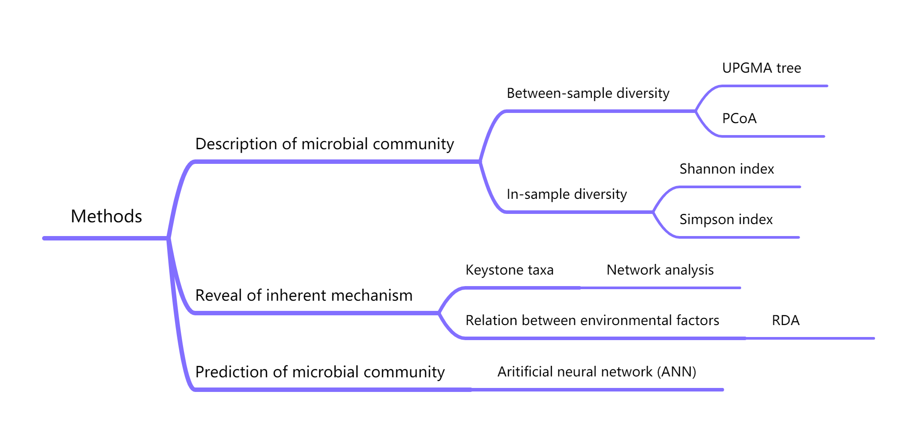
GUO YIXIN
II. Data & Methods —— Methods
What’s new: deep learning methods have not yet been widely used in this field
3
Notes:
Clear image of books– based our known knowledge and ensure interpretability
reclassification—make sure “similar” parts are gathered together(further understanding of distribution)
Parameters to know about diversity, network analysis and CCA, we make predictions based on known mechanism
New way—let computer learn from big data(NN)—black box

Slide 5
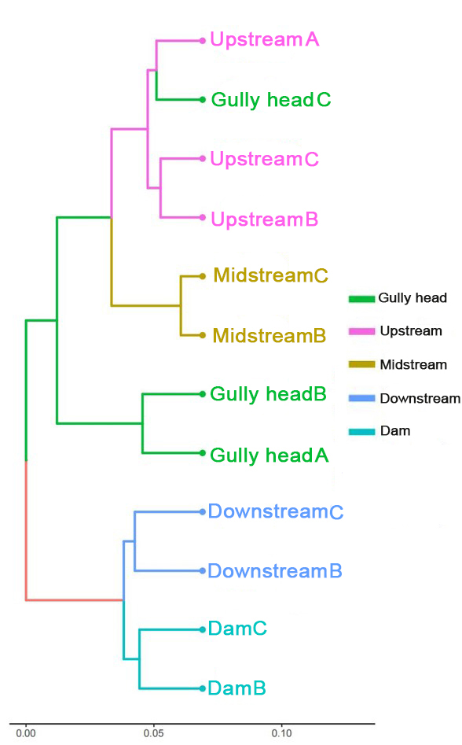
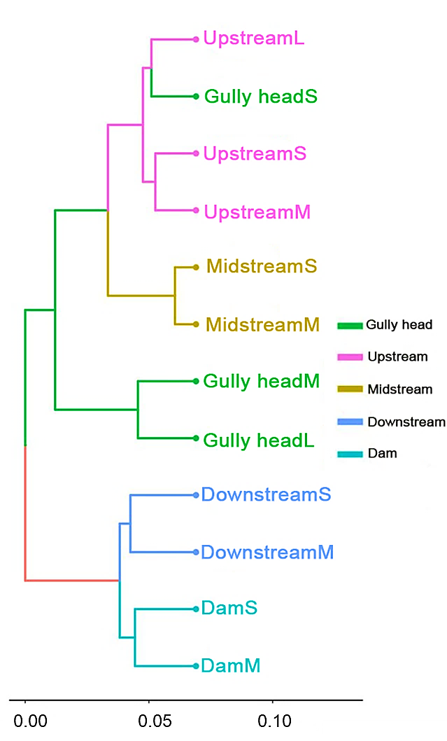
QIU HAOHONG
III. Results & Interpretation —— β-Diversity: UPGMA tree
A, B, C: sampling repeats
Bray-Curtis dissimilarity: widely used in microbial data
What can we know from this figure
1
Color —— different sampling sites
Distance —— measurement of similarity
Structure —— 1, 2, 3 indicate the reclassification result of the sampling sites
2
3
UPGMA tree of soil bacterial communities
4

Slide 6
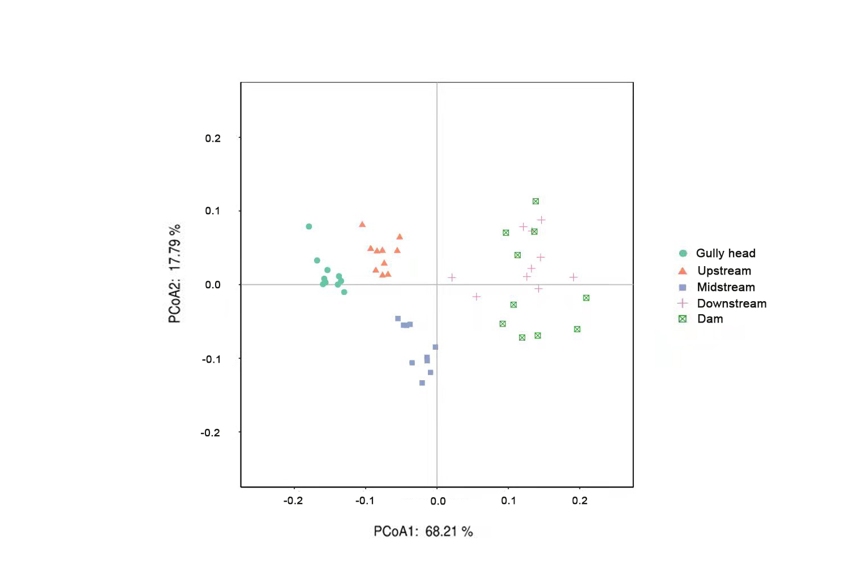
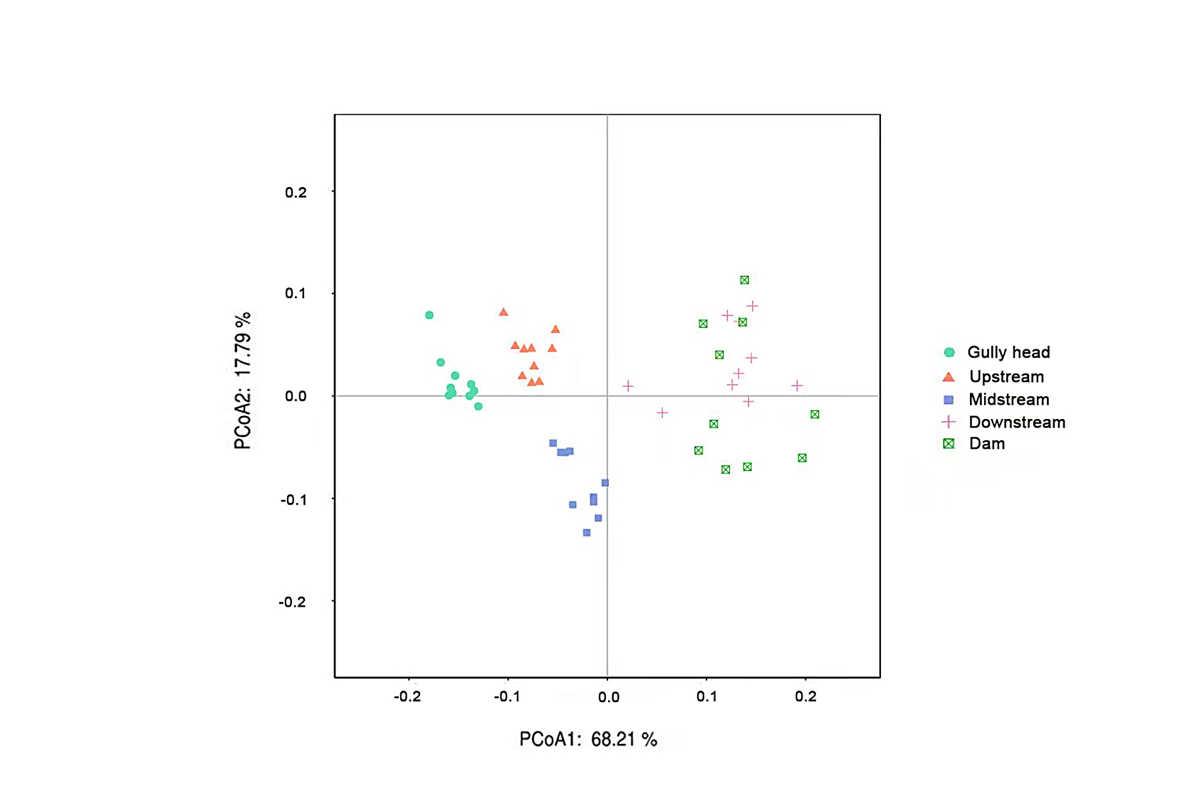
QIU HAOHONG
III. Results & Interpretation —— β-Diversity: PCoA
Between-sample diversity
Similarity with UPGMA tree:
Rationale: Bray-Curtis dissimilarity
Differences:
Dimension reduction method
Better understanding
PCoA of soil bacterial communities
5

Slide 7
PENG BOHAO
III. Results & Interpretation —— Top 10 microbes
Relative abundance of soil bacterial communities
Relative abundance of soil fungal communities
Dominant bacteria: Proteobacteria, unidentified_ Bacteria, Cyanobacteria
Proportion: more than 60%
Dominant fungi: Ascomycota, Basidiomycota, Chytridiomycota
Proportion: more than 50%
6

Slide 8
PENG BOHAO
III. Results & Interpretation —— α-Diversity: Shannon index
Abundance and diversity of soil bacterial communities
Abundance and diversity of soil fungi communities
Shannon index: the higher the Shannon index, the better the microbial diversity
Microbial diversity: upstream ＞ downstream
7

Slide 9
PENG BOHAO
III. Results & Interpretation —— α-Diversity: Simpson index
Abundance and diversity of soil bacterial communities
Abundance and diversity of soil fungi communities
Simpson index: the lower the Simpson index, the better the microbial diversity
Microbial diversity: upstream ＜ downstream ？
8

Slide 10
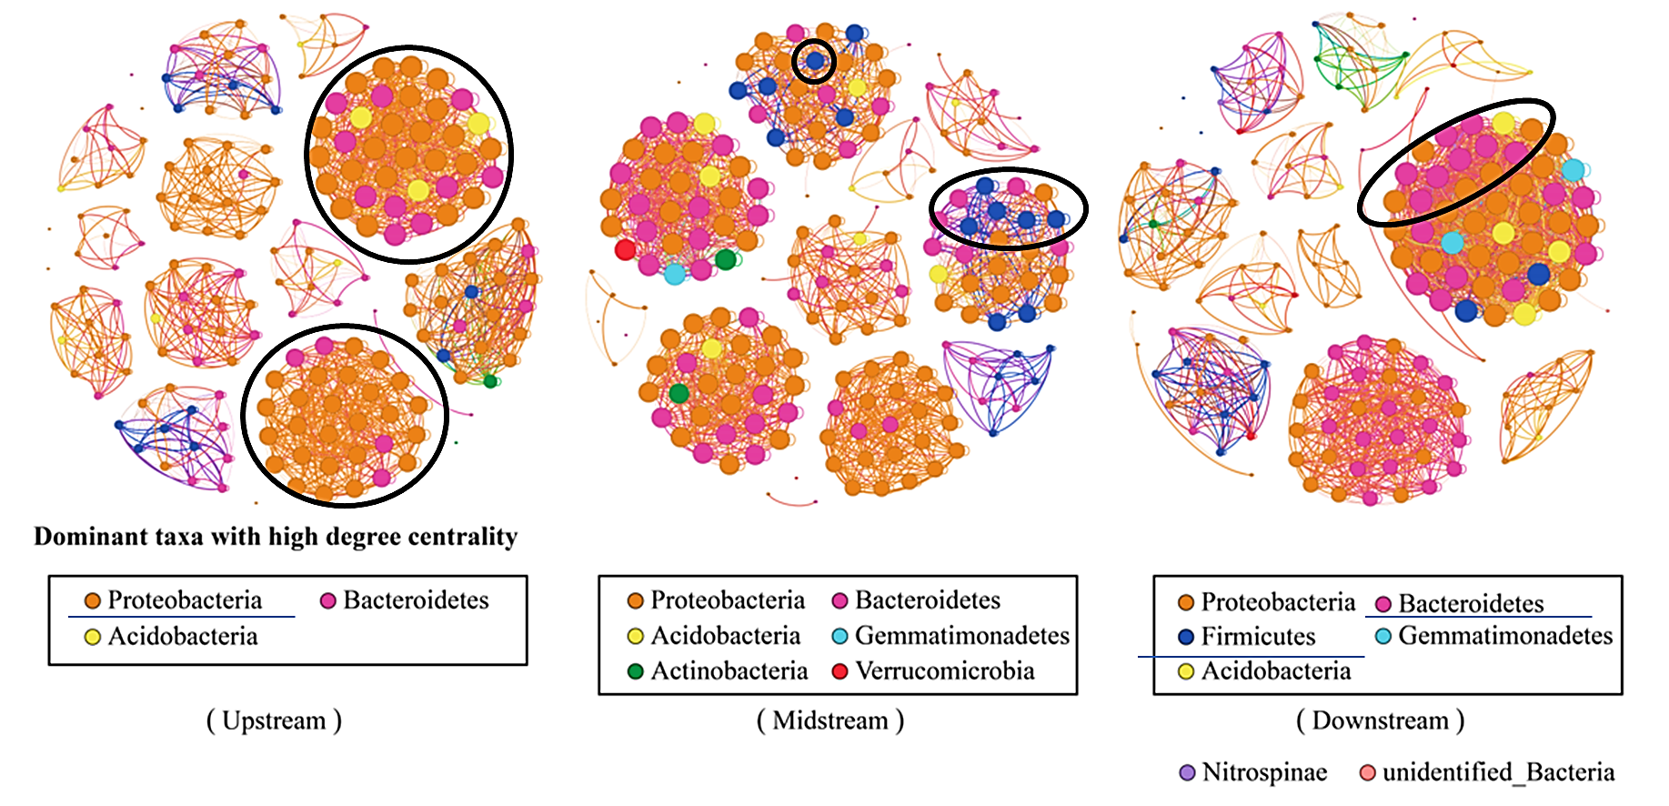
HOU RUIHAN
III. Results & Interpretation —— Network analysis
Network analysis of microbial community in upstream ,midstream and downstream
Keystone taxa: Proteobacteria, Firmicute, Bacteroidetes
Community structure: unbalanced —— relatively balanced —— unbalanced
9

Slide 11
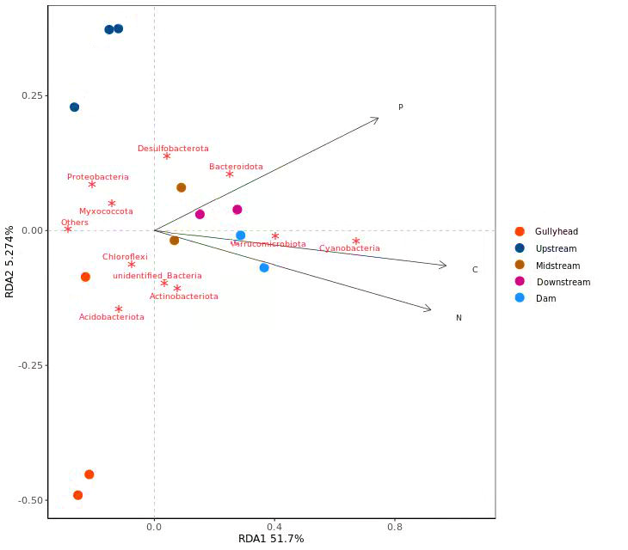
HOU RUIHAN
III. Results & Interpretation —— Redundancy analysis
Arrows: soil properties
Significant correlation
The absolute abundance of C, N and P
10
Redundancy analysis of microbial community

Slide 12

WEN YUFENG
III. Results & Interpretation —— ANN construction
1) ANN Construction
3 Features, 12 Data
135 Data
135 models
Each: 3 inputs → 1 output
C (g/kg)
N (g/kg)
P (g/kg)
Bacterial & fungal taxa
Relative abundance
11

Slide 13
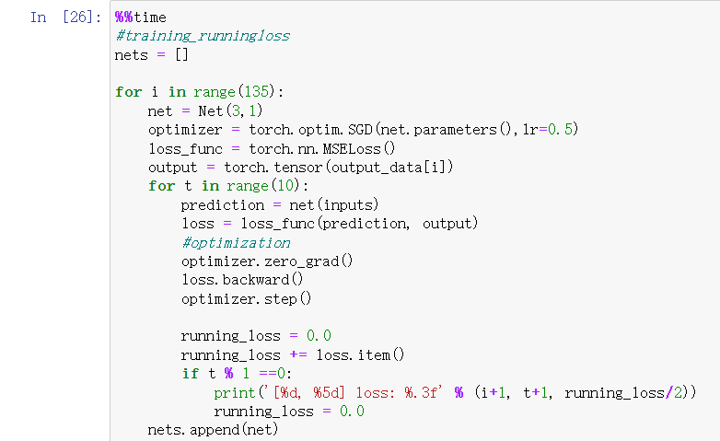
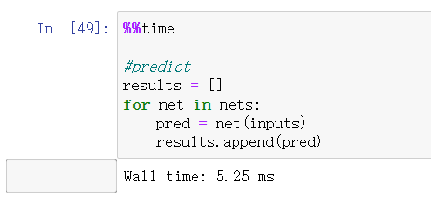
WEN YUFENG
III. Results & Interpretation —— ANN construction
2) Training & Testing
Training Time: 576 ms
Testing Time: 5.25 ms
12
Notes:
Mean Square Error (MSE): is the most commonly used regression loss function. MSE is the sum of squared distances between our target variable and predicted values.

Slide 14
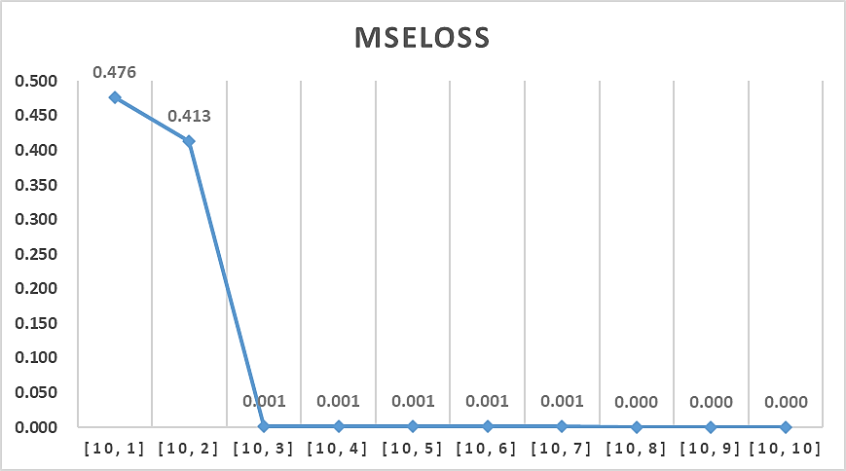
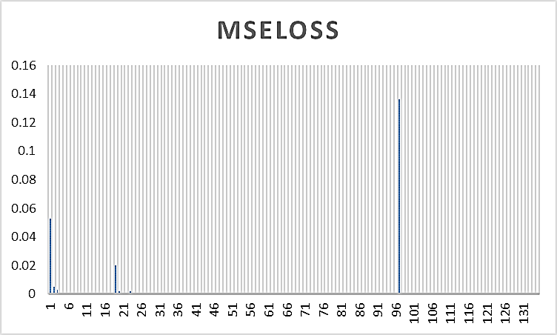
WEN YUFENG
III. Results & Interpretation —— ANN construction
3) MSELoss
MSELoss: Mean Square Error loss function
The smaller, the better
MSELOSS
MSELOSS
Model #10 (Mucoromycota)
All 135 Models
Mean MSE₁₃₅: 0.0017
13
Notes:
Mean Square Error (MSE): is the most commonly used regression loss function. MSE is the sum of squared distances between our target variable and predicted values.

Slide 15



WEN YUFENG
IV. Application & Evaluation of the result
Application: Prediction
Evaluation 1: Future Prospect
Bacteria & fungus (135)
Taxa & relative abundance
Ecosystem preservation, agriculture …
SEM (structural equation model)
ANN: Compare sklearn & PyTorch (used)
A more sophisticated neural network
Evaluation 2: Homework Questions
Data: reliability, accessibility, dearth
Application: over-fitting → more practical
14

Slide 16
V. Conclusion
Limitation
Contribution
Small dataset
Simple neural network
Limited environmental factors in RDA
Deep learning method in soil microbe field
What we have learned
AI and microbe related knowledge
Team spirits
Time managing tools
15

Slide 17
VI. Reference & Bibliography
https://heartbeat.comet.ml/5-regression-loss-functions-all-machine-learners-should-know-4fb140e9d4b0#:~:text=Mean%20Square%20Error%20%28MSE%29%20is%20the%20most%20commonly,the%20predicted%20values%20range%20between%20-10%2C000%20to%2010%2C000.
https://github.com/MorvanZhou/PyTorch-Tutorial/tree/master/tutorial-contents
https://jokergoo.github.io/ComplexHeatmap-reference/book/
https://www.data-to-viz.com/
http://www.bioinformatics.com.cn/plot_basic_PCoA_plot_035
https://ggplot2-book.org/
JIAO, S., LIU, Z. S., LIN, Y. B., YANG, J., CHEN, W. M. & WEI, G. H. 2016. Bacterial communities in oil contaminated soils: Biogeography and co-occurrence patterns. Soil Biology & Biochemistry, 98, 64-73.
Qian, X., Chen, T., Xu, Y., Chen, L., Sun, F.X., Lu, M., & Liu, Y. (2020). A guide to human microbiome research: study design, sample collection, and bioinformatics analysis. Chinese Medical Journal, 133, 1844 - 1855.
Hong, F., Chang, Y., Fan, Z., Zhu, W., & Jin, M. (2019). Study on Soil Microbial Community Structure of River Wetland in Tumen River Basin. IOP Conference Series: Earth and Environmental Science.
LARSEN, P. E., FIELD, D. & GILBERT, J. A. 2012. Predicting bacterial community assemblages using an artificial neural network approach. Nature Methods, 9, 621-+.
WANG R., SALMAN A., GAO X., GUO S. L. 2019. Variations of soil microbial communities along a valley bottom of the loess plateau and the influencing factors. China Environmental Science, 39, 4350-4359
16

